Slide 1

Instant Coffee
Consumer Analysis

Slide 2
Knowing your customer segments is essential to continuous success
Consumer split and hypotheses
Heavy consumer
Light consumer
Price sensitive
Opportunistic behaviour
‘Loves’ his brand
Price sensitive
Combines purchases with regular shopping
Low brand loyalty
Consumers are segmented by their average weekly purchase volumes

Slide 3

Data transformation enabled the identification of distinct price elasticities and purchasing patterns for both groups
Data aggregation
Transactional level raw data
Aggregation by
week and brand
Aggregation by
week and household
PRICE ELASTICITIES
PURCHASING PATTERNS

Slide 4
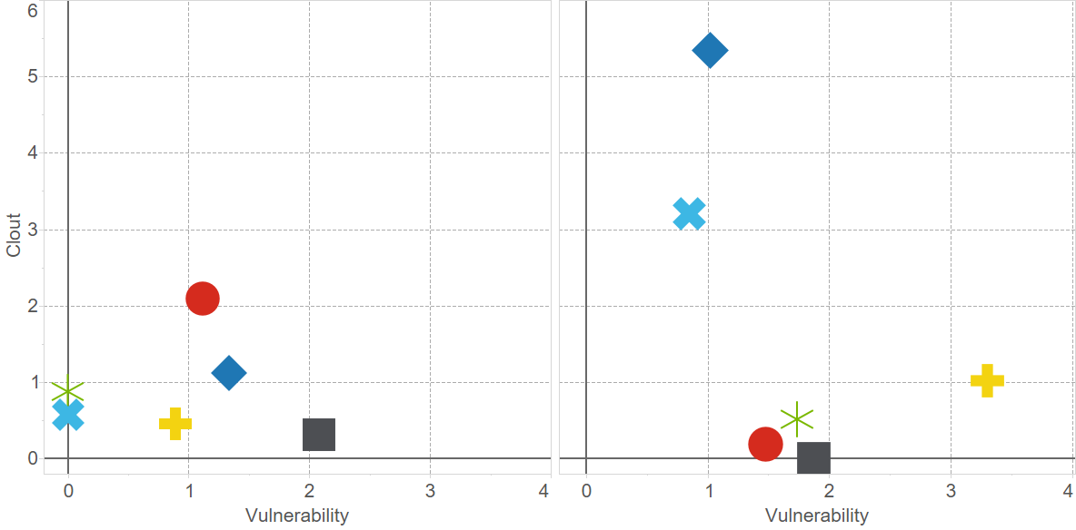
Heavy consumers tend to be more price sensitive with Kenco being the most vulnerable brand
Price elasticities by brand and consumer group
Light consumers
Heavy consumers
Carte
Douwe
This chart could be simplified into a 2x2 matrix (high clout, low clout, high vuln…)
Nescafe
Kenco
Clout
Supermarket
Other
*
Vulnerability

Slide 5

They also exhibit different purchasing patterns…

Slide 6
The consumer groups‘ purchasing behaviour can be distinguished by multiple dimensions
Consumer split
Importance [Random Forest]
0
25
Promotion responsiveness (Price)
Maximum spend per visit
Average packs per visit
Average spend per visit
Average weekly visits
Minimum spend
Brand choice
Promotion responsiveness (Units)
Store choice

Slide 7
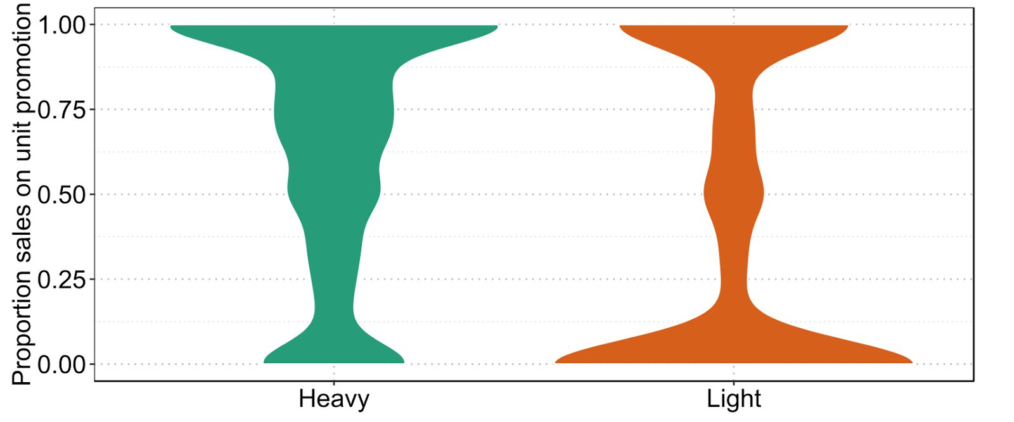
Promotions are the key to unlock the heavy consumer segment potential
Purchasing behaviour – Promotions [1]
100
Heavy consumer
75
Light consumer
Sales on unit promotion [%]
50
25
0

Slide 8
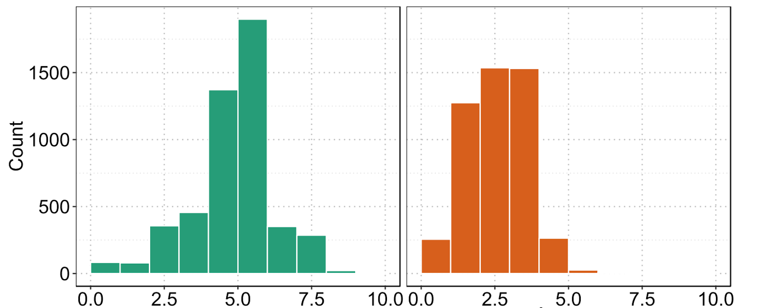
Heavy consumers spend significantly more on a shopping trip than light consumers
Purchasing behaviour – Spend
Heavy consumer
1,500
Light consumer
Number of households
1,000
500
0
0.0
2.5
5.0
7.5
10.0
0.0
2.5
5.0
7.5
10.0
Maximum spend in any single trip [GBP]

Slide 9
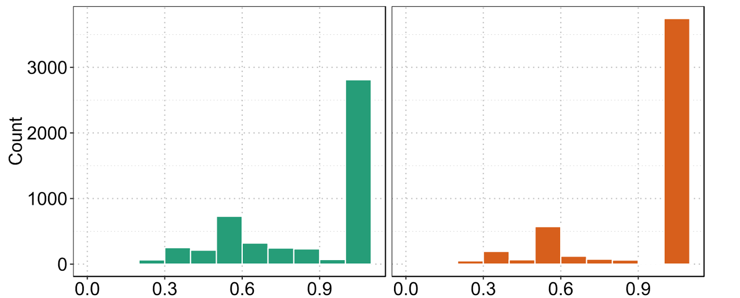
Heavy consumers are less loyal to brands and stores
Purchasing behaviour - Loyalty
Heavy consumer
1,500
Light consumer
Number of households
1,000
500
0
0.0
0.3
0.6
0.9
0.0
0.3
0.6
0.9
Brand loyalty [Herfindahl]

Slide 10
Transaction level data contains valuable information on customers and enables data-driven business decisions
Consumer segments – Hypotheses revisited
Heavy consumer
Light consumer
Price sensitive
Opportunistic behaviour
‘Loves’ his brand
Price insensitive
Combines purchases with regular shopping
Low brand loyalty

Slide 11

Heavy consumer segment can be steered towards higher volume purchases by promotions
Recommendations
Heavy consumer products (e.g. large packs)
Smart promotions (react fast and efficient to competitor promotions)
Direct brand-to-customer
loyalty scheme

